Slide 1
Perceptron and Bayes classifier (3.10) (4.8)
091601
  by Huafu Chen, China

Slide 2
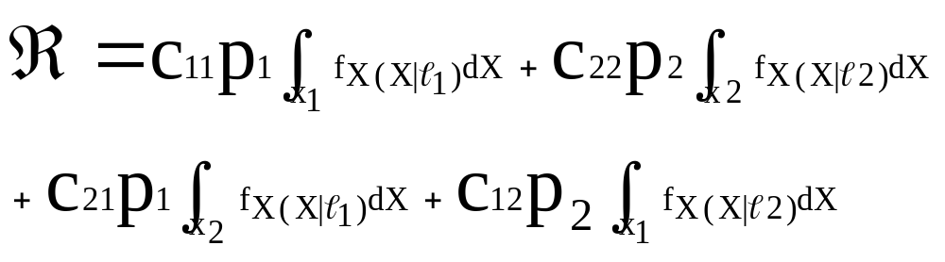
Bayes Classifier
Bayes Classifier Minimizes the average risk, denoted by R.
(3.72)
pi- a prior probability that the observation vector x is drawn from subspace Xi,i=1,2, p1+p2=1.
cij – cost of deciding in favor class Li represented by subspace Xi when class Lj is true. (i,j)=1,2.
The first two terms represent correct decisions, last two terms incorrect decisions.
Notes:
The first two terms represent correct decisions { fx(x|l1)在x1中积分， fx(x|l2)在x2中积分}, last two terms incorrect decisions.
前两项也表示 分类正确时的风险 如（fx(x|l1)在x1中积分，
而 后两项 则 表示 分类不正确时的风险 如（fx(x|l1)在x2中去积分。
Here /page 187
The objective of the experiment is to distinguish between two classes of “overlapping”（ two dimensional, gaussian-distributed patterns labeled 1 and 2.）
这里考虑 划分两类实际分布空间有交叠的 分类问题（既积分空间x1 x2应该有交迭，但这里取不交迭的，因此有丢失，即不能正确分类的部分），即找一条最佳的分类boundary, 使得风险最小。
在这里，每一类 的概率分布 都可能散布整个空间(X1+X2=X)， 因此，他们在X的积分为1， 但在划开的子空间中(X1 or X2)就不再为1，此即 （3。72）,寻求一个最佳的划分，使得 R 最小

Slide 3
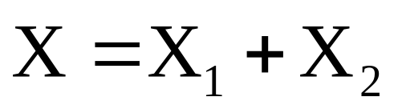
Bayes Classifier
Each observation vector x must be assigned in overall observation space X to either X1 or X2:
(3.73)

Slide 4
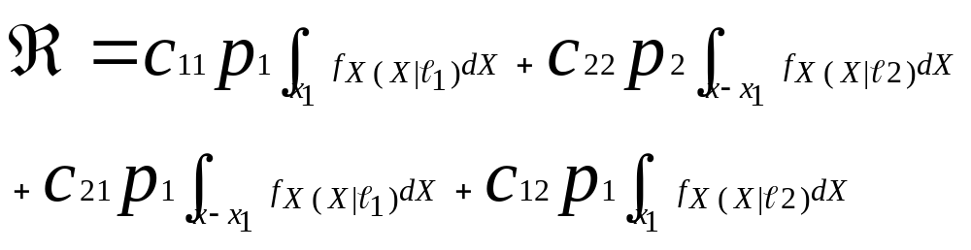
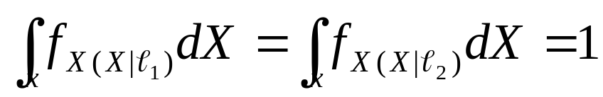
Bayes Classifier
(3.74)
(3.75)
Fact of probability density:
Notes:
L1 and l2 denote the set of events for which a random vector x belongs to patterns 1 and 2, respectively.
(3.75)的积分空间包含了 l1 和 l2 （尽管他们可能有部分交叠），但是 覆盖了属于 l1 的 events 的空间，因此，相当与 fx(x|l1) 在其全空间中积分，自然应该为 1

Slide 5
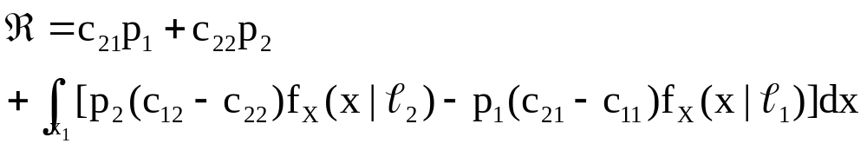
Bayes Classifier
(3.76)
The first two terms are constants
1. All values of the observation vector x for witch the integrand is negative should be assigned to subspace X1. (把一个观测归入X1得到负的积分，即能使R减小， 因此 归入 X1是对的）
2. All values of the observation vector x for witch the integrand is positive should be assigned to subspace X2. (把一个观测归入X1得到正的积分，将使R增大，因此归入 X1是错的，应归入 X2是对的 ）
3. If the integrand =0, it can be assigned arbitrarily, here assume subspace X2.
Notes:
这里虽然是积分，但可以理解成 求和，一个点 x，如果使积分为正，则划为 第2 类，否则划为第 1 类

Slide 6
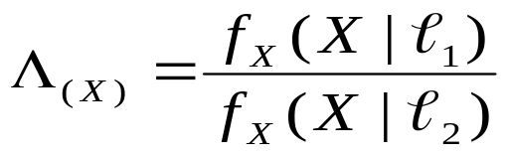
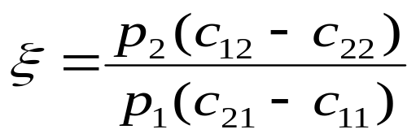
Formulate the bayes classifier
If the condition
Holds, assign the vector x to X1, otherwise assign x to X2.
For simplification, define
(3.77)
Likelihood ratio:
(3.78)
Threshold/constant:
Notes:
Here C21 always > c11
c12 always c22 分错情况的 cost 自然是大于 分对了的情况
dz

Slide 7


Figure3.10 Two equivalent implementations of the Bayes classifier:
Bayes Classifier
X
Likelihood
Ratio
computer
∧_{(X)}
Assign X to class ℓ₁
If
Otherwise, assign it to class ℓ_{2.}
Comparator
ξ
Assign X to class ℓ1
If
Otherwise, assign it to class ℓ2.
X
Log-likelihood
Ratio
computer
_{Log ∧(X)}
Comparator
logξ

Slide 8
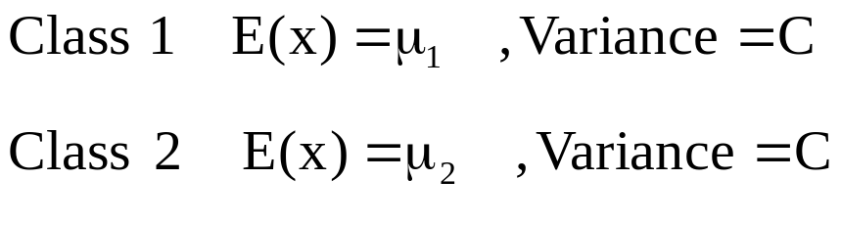
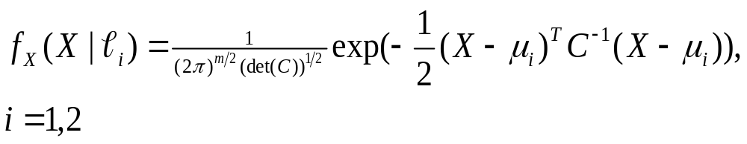
Bayes Classifier
For a Gaussian Distribution
Suppose:
(3.79)

Slide 9
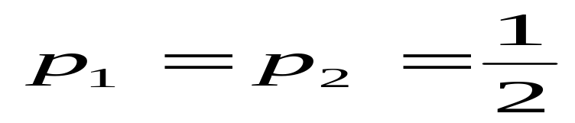
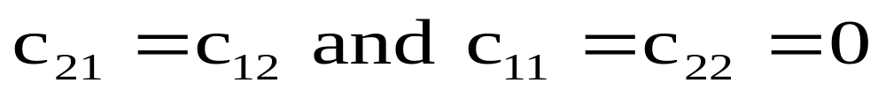
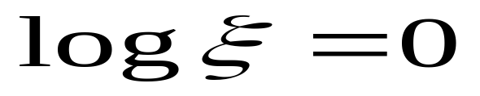
Bayes Classifier
Further assumed that
1) Two classes are equiprobable
(3.80 )
2) Misclassifications carry the same cost, and no cost is incurred on correct classifications
(3.81)
Substituting (3.80) and (3.81) in (3.78) and taking the natural logarithm, we get
(3.83)

Slide 10
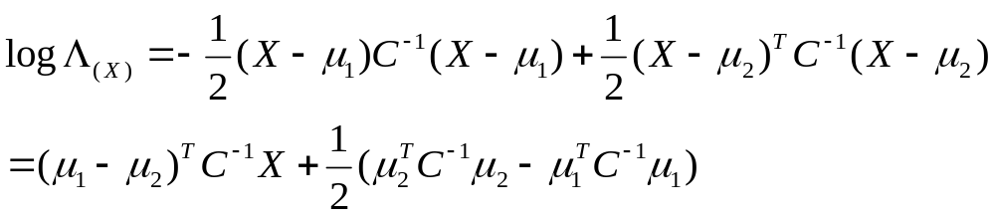
Bayes Classifier
Substituting (3.79)) in (3.77) and taking the natural logarithm, we get
(3.82)

Slide 11
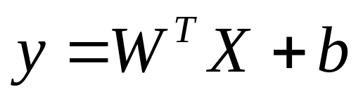
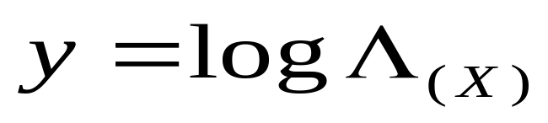
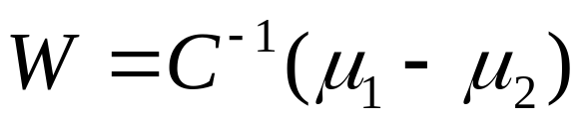
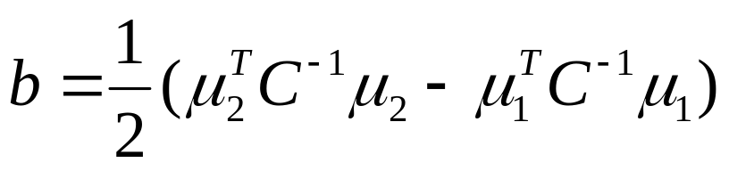
Bayes Classifier
(3.82) may be rewritten as
(3.84)
Where
(3.85)
(3.86)
(3.87)
Notes:
在这里 对数 likelihood 就象 NN的输出，但这里的对数 likelihood 是（3.82)，其中有归一化 方差运算，有对数运算，原则上我们可以设计 神经网络，让其不同的环节就按这样的运算去操作（如仿生性的NN)，但这里我们要作的是用 比较通用的 ANN 去近似这些函数的功能！结果（3.84）表明，对高斯分布情况，我们好象可以用线性组合就可以了。

Slide 12
Bayes Classifier
In summary
On the basis of (3.84), the classifier consists of a linear combiner with weight vector w and bias b, as shown in Fig.3.11 page 147.
If the output y of the linear combiner is positive , assign the observation vector x to class 1, otherwise, assign it to class 2.
As a linear classifier, Bayes Classifier for the Gaussian environment is similar to a perceptron.
b (bias)
x₁
w₁
Fig.3.11 Signal-flow graph
x₂
w₂
y
w_{m}
x_{m}

Slide 13
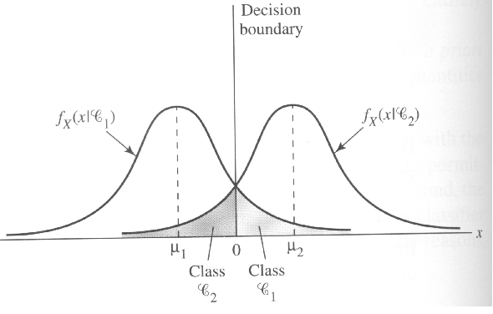
Bayes Classifier
Difference:
The Perceptron operates on the promise that the patterns to be classified are linearly separable.
The Gaussian distribution of the two patterns assumed in the derivation of the Bayes Classifier certainly do overlap each other and are therefore not separable.
The Bayes Classifier minimizes the probability of classifier error. This minimization is independent of the overlap between the underlying Gaussian distributions of the two classes. Fig. 3.12 (page 148)
Figure 3.12
Two overlapping, one-dimensional Gaussian distributions

Slide 14
Bayes Classifier
The perceptron convergence algorithm is nonparametric in the sense that it makes no assumptions concerning the form of the underlying distributions.
The Bayes classifier is parametric, its derivation is contingent on the assumption that the underlying distributions are Gaussian, which may limit its area of application.
The perceptron convergence algorithm is both adaptive and simple to implement, its storage requirement is confined to the set of synaptic weights and bias.
The design of the Bayes classifier is fixed, it can be made adaptive, but at the expense of increased storage requirements and more complex computations.
Notes:
Contingent: 可能发生的，偶然的
be contingent on 依什么而定的

Slide 15
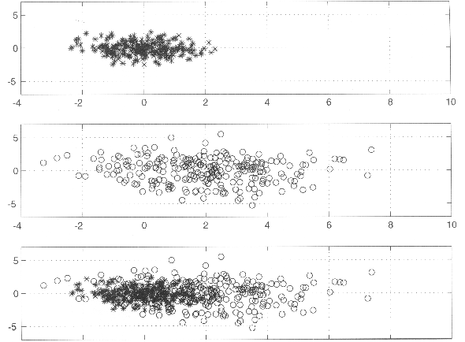
4.8 Computer experiment
Suppose there are two 2D gaussian distributed patterns
Figure 4.14 (a) Scatter plot of class L1; (b) scatter plot of class L2; (c ) Combined scatter plot of both classes

Slide 16
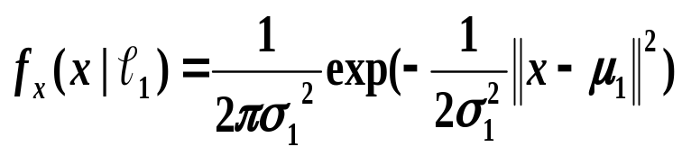

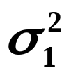



4.8 Computer experiment
Suppose there are two 2D gaussian distributed patterns
(4.56)
Class l₁:
where =mean vector =[0,0 ]^{T}
=variance=1
Class l₂:
where =[2,0]^{T}
=4
(4.57)
Suppose the two classes are equiprobable

Slide 17
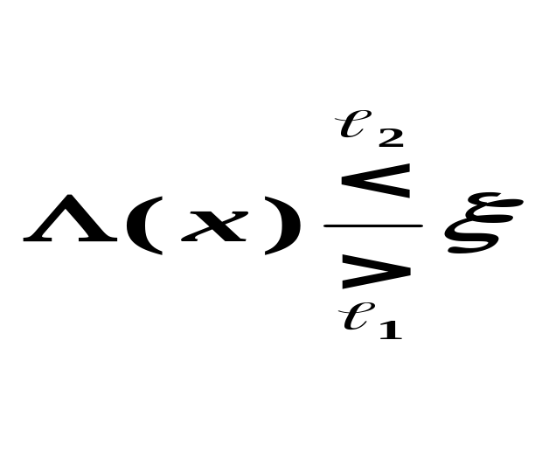
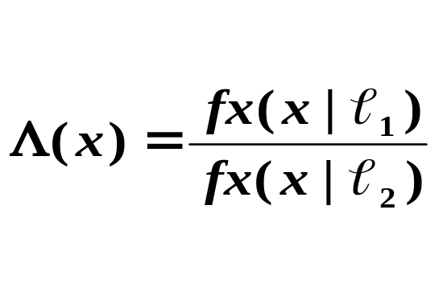
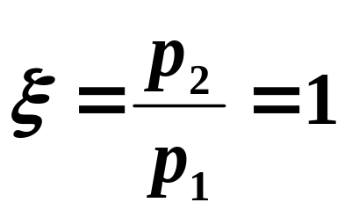
4.8 Computer experiment
Bayesian decision boundary
(4.58)
Likelihood ratio:
(4.59)
Constant
(4.60)

Slide 18
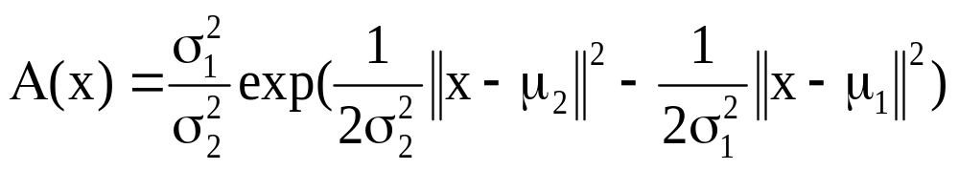
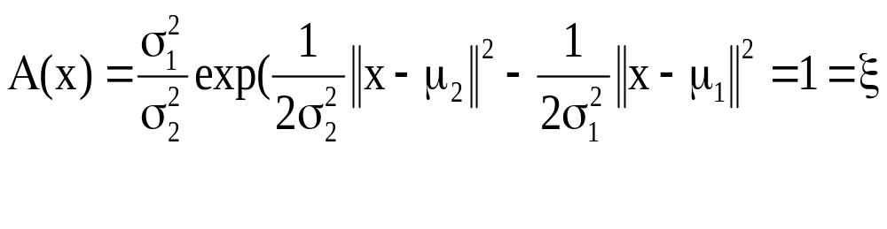
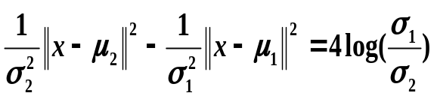
4.8 Computer experiment
The optimum (Bayesian) decision boundary is defined:
Or equivalently,

Slide 19
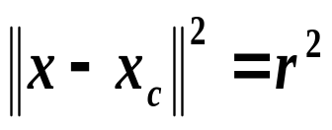
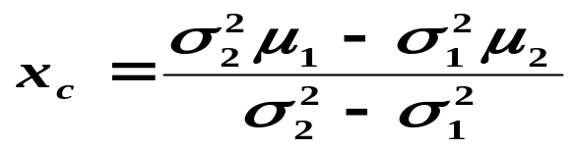
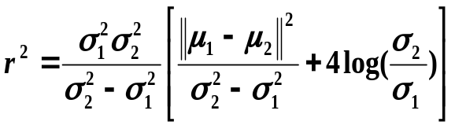
4.8 Computer experiment
(4.61) may further be simplified to

Slide 20
4.8 Computer experiment
In summary
For this problem:
Classify the observation vector x as belonging to class 1 if the likelihood ratio is greater than the threshold, and to class 2 otherwise.
For this specific problem, we have a circular decision boundary
whose center is located ( -2/3, 0),
And whose radius is r=2.34.

Slide 21
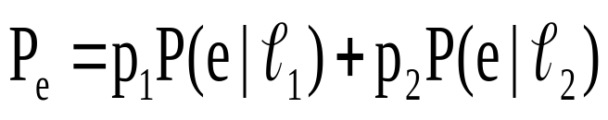
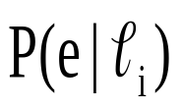


4.8 Computer experiment
The probability of error (misclassification), Pe, of a classifier operating according to the Bayesian decision rule is
Is the conditional probability of error given that the classifier input vector was drawn from the distribution of class i.
For this problem, we may numerically evaluate the values:
Notes:
page 191 Let c denote the set of correct classification outcomes, and e the set of erroneous classification outcomes.
这里 P(e|l1）应该就是按照，上面画出的那个决策圆 进行积分，l1的样本位于 圆外的部分为 0.105
从figure 4.14 看，画一个圆 把 l1 包含好 比把 l2来得容易，因此，P(e|l1)=0.105 <P(e|l2)=0.264

Slide 22


4.8 Computer experiment
With
We have
and

Slide 23

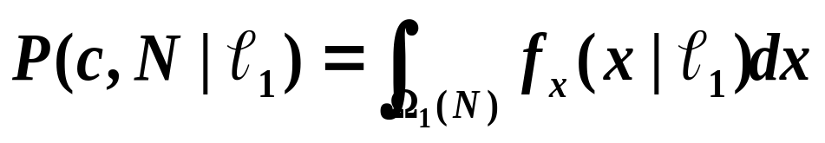
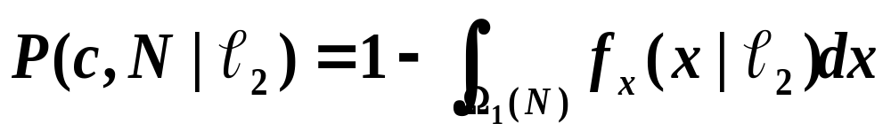
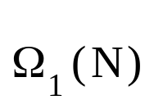
4.8 Computer experiment
For perceptron, we may get a final decision boundary
where p₁=p₂=1/2, and
is the region in decision space over which MLP (trained with N patterns) classifies the vector x ( representing a realization of the random vector x) as belonging to class 1.
Notes:
Y=WX+B=constant (for example zero, for gaussian distirbution), this is a curve which forms a boundary in the 2D space
分成两类就是一个常数，分成多类 就是多个常数 （4.55)
-- page 198, figure 4.17/see following ppt)
Here “c” in P(c,N|l1), means correct classification, N the number of training patterns
Is the region in decision space over which the multilayer perceptron (trained with N patterns) classifies the vector x ( representing a realization of the random vector x) as belonging to class 1.
The decision boundary ( by eq.(4.55 )) can not easily be found, see page 192, last 4 lines.
在这里，根据（4.55）,决策边界的确定不是很容易，往往是根据收敛后的网络的映射函数来定，如规定 Fk(x)>Fj(x),则认为它属于k类
在上一张 ppt中讲了 Bayes 分类中，分类效果的评价方法，
在这里，原则上是这一张中的公式，但实际上 区域不好确定The decision boundary can not easily be found, see page 192, last 4 lines.
，而是
用书中的公式 P_{N}=A/N来计算的，page 193
其中还谈到了 检验样本 数量的要求 。

Slide 24
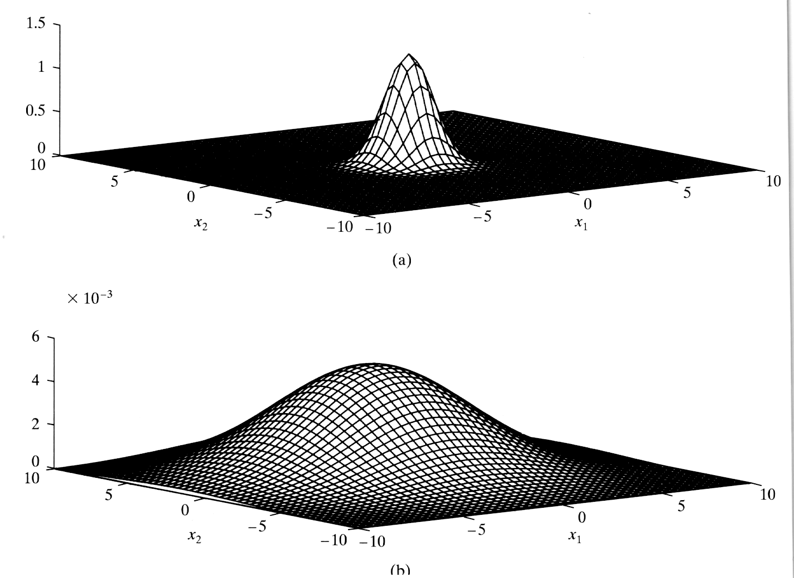
Fig. 4.13 / page 188

Slide 25
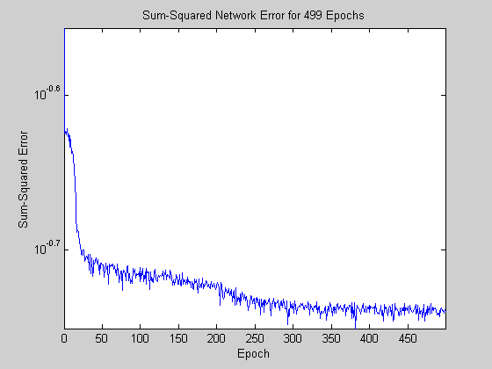
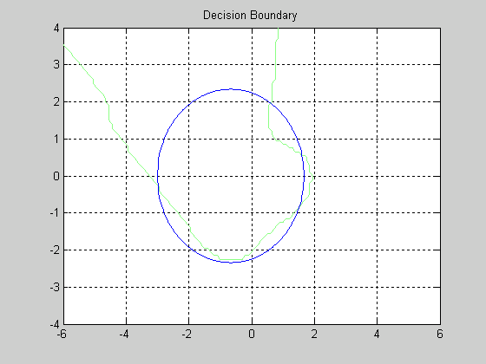
CASE 1.改变网络隐含层和学习率：
训练样本数：500。
训练次数： 500。
网络隐含层：6。
输出节点个数：2。
输入向量维数：2。
学习率： 0.2。
结果如下：
正确识别率：79.7%
4.8 Computer experiment
BP算法的分类仿真：
训练中的均方误差
得到的分类曲线：

Slide 26
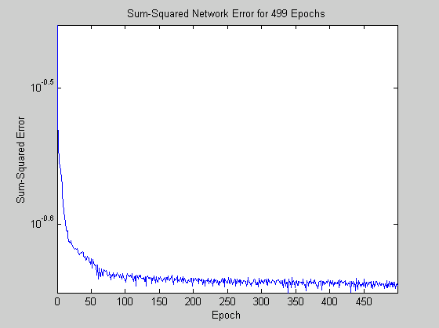
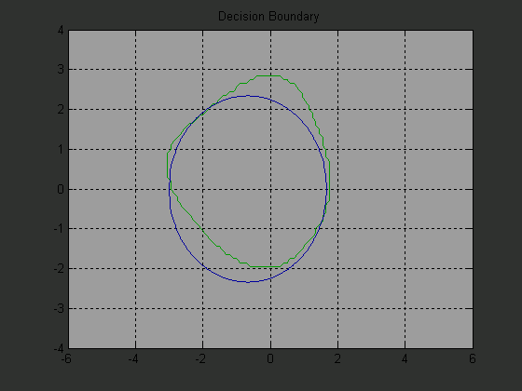
Case 2:
训练样本数：500。
训练次数： 500。
网络隐含层 神经单元数：4。
输出节点个数：2。
输入向量维数：2。
学习率： 0.1。
结果如下：
正确识别率：80.3%
4.8 Computer experiment
BP算法的分类仿真：
得到的分类曲线：
训练中的均方误差

Slide 27
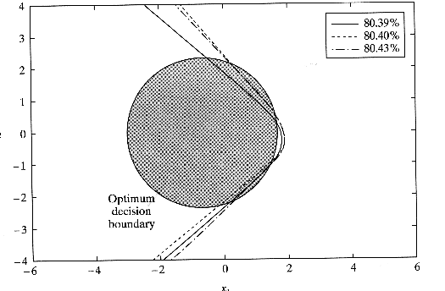
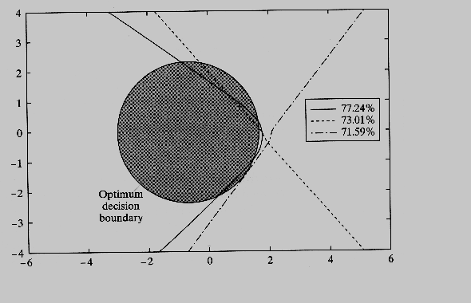
4.8 Computer experiment (4.17 a b)
Three nice NN results
Three poor NN results

